Slide 1
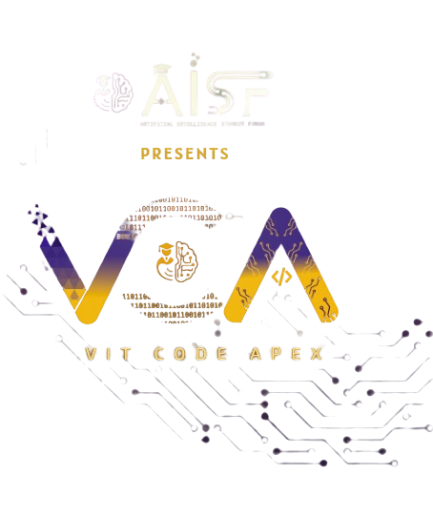

Slide 2

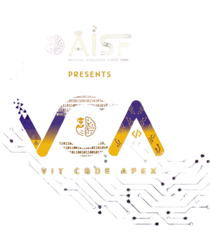

CODE VERSE HACKATHON 2025
Problem Statement Title- Create a "living itinerary" system that dynamically adjusts a traveler's plans in real-time based on live events and user feedback.
Team Name- TripSync:)
Team Members- Suyash Chandolikar
Swayam Chandak
Shriraj Nelekar
Vanshika Dongare

Slide 3




TripSync:)
Innovative Approach
Proposed Solution
How It Addresses
AI-powered itinerary builder
Single platform for all bookings
Automated rebooking & updates
Smart assistant for Q&A
Travel story & highlights
User preference–driven planning
Avoids juggling multiple apps
Handles delays easily
Saves traveler’s time and effort
Stress-free travel
Personalized trips
Creates sharable travel memories
Real-time adaptive plans
Unified multi-source data
Automation-first travel
Personalized AI guidance
Post-trip memory journal
Context-aware suggestions

Slide 4

How the Living Itinerary Works
@reallygreatsite
User enters origin, destination, dates, budget, interests.
STEP-1
CREATE
Gemini LLM + Pinecone retrieve flights, trains, hotels, top places to visit, and generate a full day-by-day itinerary.
Live data collected from Indian APIs
STEP -2 SENSE
Using different open source APIs of flight , trains , news , weather , traffic , live events.
STEP-3 PLAN & RE-PLAN
Gemini LLM analyses disruptions, retrieves relevant context from Pinecone
And then generates updated portions of the itinerary
n8n executes bookings/reschedules via external APIs.FastAPI updates Postgres and sends notifications.
STEP-4 ACT & PRESENT
React/TypeScript front-end shows the updated plan with accept/decline options and chat interface.

Slide 5
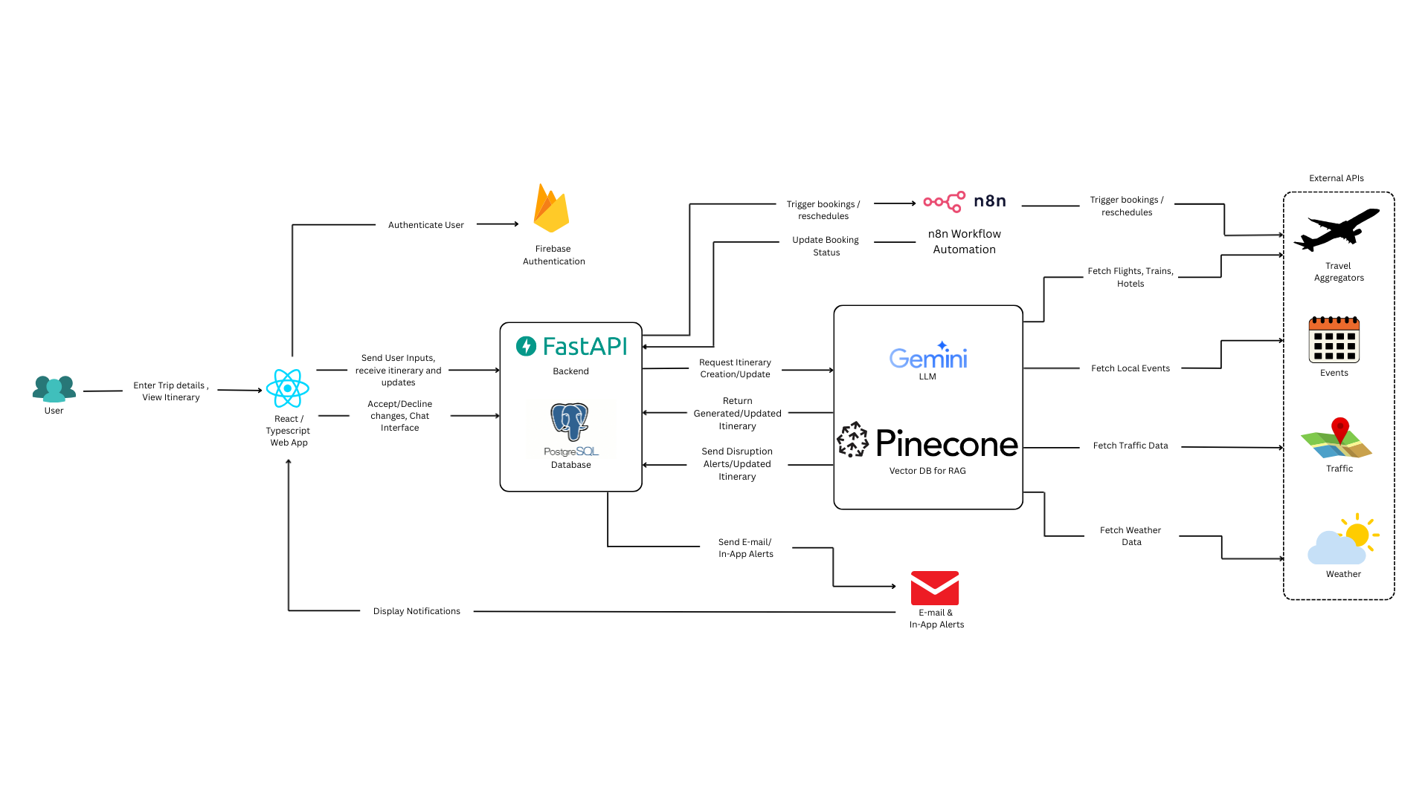
Detailed Methodology

Slide 6
Methodology
Knowledge Grounding (Pinecone RAG)
Stores policies, preferences & routes as vectors
Retrieves context for Gemini’s decision-making
Instead of keyword lookups, Pinecone uses semantic similarity to fetch relevant data even if the phrasing differs.
Filtering by tags (e.g. “company=XYZ”, “region=EU”) keeps retrieval precise.
API Integration (FastAPI)
Unifies data from flights, trains, hotels, weather & maps
Normalises responses for itinerary creation
Agent Orchestration (n8n)
Event-driven workflows for bookings/disruptions
Gemini LLM generates new/updated plans
External API calls for booking & rebooking
Data & Authentication
Postgres: itineraries, bookings & transactions
Firebase: secure user authentication & tokens
Front-end (React/TypeScript)
Real-time dashboard: itineraries, updates, approvals
Chat-based interaction with AI assistant

Slide 7

Innovation and Indian Context
Innovation
Moves beyond static itinerary apps
Autonomous planner: create, re-plan, execute
Combines reasoning (LLM), action (n8n), retrieval (Pinecone)
Benefits
Auto itinerary creation & updates
Seamless rebooking & recommendations
Transparent, context-backed decisions
Stress-free travel experience
Why India-Focused
IRCTC trains & DGCA flights
Indian hotel/OTA APIs
IMD weather & traffic maps
Regional news & multilingual alerts

Slide 8
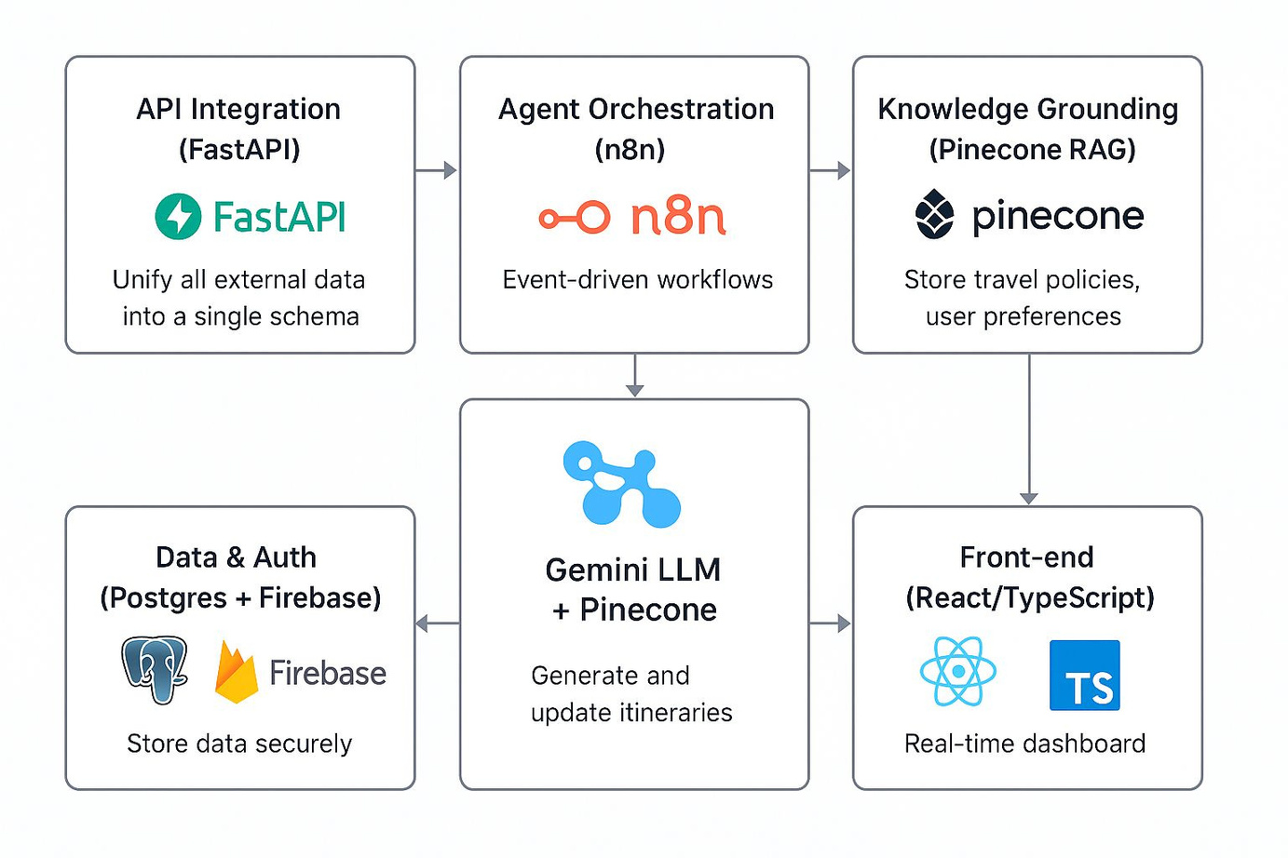
TECHNOLOGIES USED

Slide 9
FEASIBILITY AND VIABILITY
Potential
Scalable: Supports horizontal scaling
Cost-Efficient: Pay-as-you-go for LLM calls & Pinecone storage
Market: Large Indian domestic travel demand
Analysis
Strategies
Data Availability: APIs for flights, trains, hotels, weather, traffic & news
Stack: Cloud-ready (FastAPI, n8n, Pinecone, Postgres, Firebase)
Costs: Open-source tools reduce licensing
Development: Modular rollout → start with itinerary creation, then add auto updates & rebooking
Operational: Real-time personalised management
Economic: Affordable, transparent pricing for sustained adoption
Feasibility & Viability

Slide 10
IMPACT AND BENEFITS
For Travellers:
Complete, personalised itinerary in one place.
Automatic updates for delays, cancellations, weather changes or new recommendations.
Multilingual notifications and chat assistance.
For Travel Providers:
Fewer customer service calls due to automated re-planning.
Higher satisfaction and repeat usage.
For India’s Travel Ecosystem:
Leverages indigenous data sources (IRCTC, IMD, regional news).
Pioneers “living itinerary” concept tailored to Indian conditions.
Overall Outcome:
Stress-free, intelligent travel planning that continuously adapts, saving time and money while enhancing the travel experience.

Slide 11
THANK YOU

